Slide 1
arXiv
Synergy: Resource Sensitive DNN Scheduling
In Multi-Tenant Cluster
J. Mohan, A. Phanishayee, J. Kulkarni. V. Chidambaram
CHANGWON NATIONAL UNIVERSITY

Slide 2




Introduction
Machine learning has become popular in recent years
DNN have been showing significant success in various applications
Such as NLP, Speech understanding, Recommendation, …Etc.
The size of DNN model is growing
GPT-3(OpenAI), BERT(Google), HYPERCLOVA(NAVER)

Slide 3
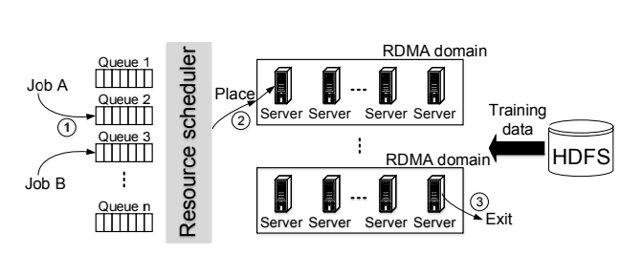
Introduction
Training DNN is resource-intensive and time-consuming
Enterprises typically setup large multi-tenant cluster with GPUs
To be shared by several users and production groups
Philly(USENIX ATC`19), AntMan(OSDI`20)
M. Jeon. et al. "Analysis of large-scale multi-tenant GPU clusters for DNN training workloads." USENIX ATC, 2019.

Slide 4
Introduction
Jobs are scheduled and managed either using traditional big-data scheduler
Kubernetes, YARN(Hadoop)
Above platforms can setting job scheduling policy(FIFO, SRTF, LAS) at cluster
Modern schedulers that exploit DNN characteristics for utilization are already exist
Themis(NSDI`20), Tiresias(NSDI`19), DRF(NSDI`11),
These schedulers focused on decide how to allocate GPU resources to many jobs

Slide 5

Introduction
Current DNN cluster schedulers assume GPUs to be the dominant resource in task
CPU, memory resources are allocated proportional to #of GPU assigned to the job
DNN also require CPU, memory resources(preprocessing, batch, …Etc.)
GPU-proportional allocation
Cluster
GPU-proportional allocation
Sever 1.
GPU : CPU : Mem
1GPU : 3CPU: 100GB
Model
profiler
2GPU : 6CPU: 200GB
Job queue
DNN jobs
Cluster
scheduler
Resource allocation
Focused on GPU!

Slide 6
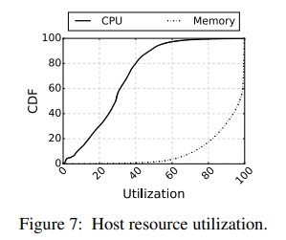
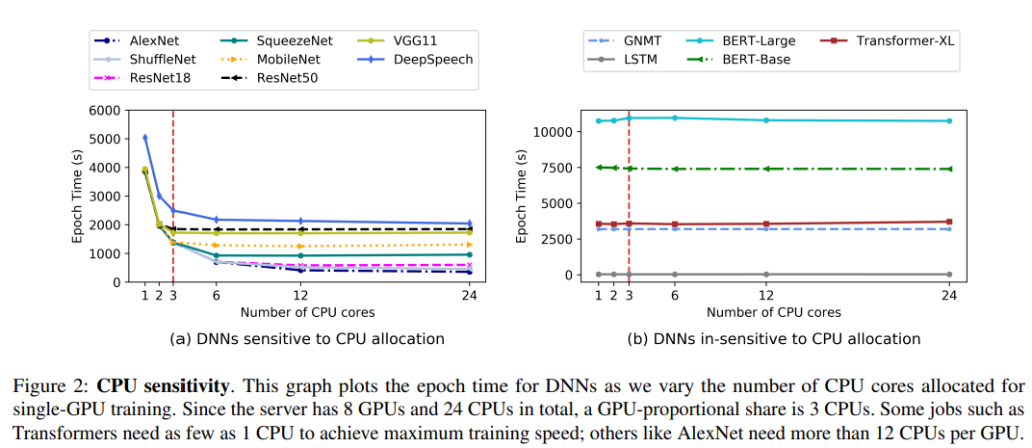
Motivation
Resource Sensitivity
DNN jobs on cluster exhibit different levels of sensitivity to CPU, and memory during training
Microsoft’s philly cluster(multi-tenant cluster) shows that CPU cycle are under-utilized.
Differ from DNN model’s characteristic (Image classification, Speech, NLP)
Image classification, Speech
Natural language processing
CPU under-utilized
Jeon, Myeongjae, et al. "Analysis of large-scale multi-tenant GPU clusters
for DNN training workloads." USENIX ATC, 2019.

Slide 7
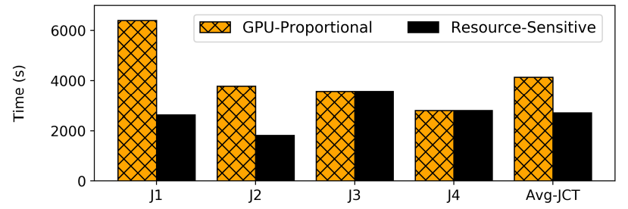
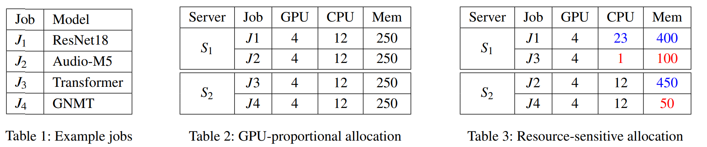
Motivation
Image, speech models benefit from larger DRAM caches.
If data is not cached, the cost of fetching it from storage can induce fetch stall in training
Memory capacity affect training throughput
Image pre-processing also require CPU resource
1.5 x
CPU, memory intensive model
CPU, Memory under-utilized

Slide 8
Motivation
Existing DNN job scheduler use round-base scheduling(Ex. 5min = 1round)
Identify the set of jobs that are runnable in the cluster using scheduling policy
FIFO, SRTF(Shortest Remaining Time First), LAS(Least Attained Service), FTF(Finish Time Fairness)
Cluster
Policy
① Collect job’s GPU demand
③ Placement decision
Model
profiler
Scheduler
② Allocation
Placement
scheme
: 4 GPU machine
: Occupied

Slide 9

Motivation
Placement scheme packs selected jobs among available server in the cluster
Multi-resource packing of jobs is analogous to bin-packing problem
Bin packing assigns the balls to the fewest number of bins.
NP-problem, Require approximate solution, heuristic
Prior works solved problem by fixed resource demands
Cluster
Policy
① Collect job’s GPU demand
③ Placement decision
Model
profiler
Scheduler
② Allocation
Placement
scheme
: 4 GPU machine
: Occupied

Slide 10
Motivation
What is Ideal resource requirement for each job and how can determined quickly?
How should we pack these jobs into server along multiple-resource efficiency?
Especially when we can tune the job’s demand for these resource?

Slide 11
Synergy: Design
Synergy is not constrain to particular scheduling policy.
Improve a wide range of scheduling policy(FIFO, LAS, SRTF, …Etc.)
Finding efficient partition of available resources among jobs to maximize throughput
Must be better than GPU-proportional allocation
FIFO, LAS, SRTF, …Etc.
Fast & efficient
job profiling
General
Scheduling policy
Resource sensitivity
job allocate
Synergy

Slide 12
Synergy: Design
Synergy is round-based scheduler for GPU that arbitrates multi resource
GPU, CPU, memory among the runnable jobs in every round
Identify the job’s best-case CPU and memory demand using Optimistic Profiling
Synergy identify a set of runnable jobs for given round using general policy
Synergy packs these jobs on to the near-optimal heuristic algorithm
End of round, the set of jobs are updated using the scheduling policy
And their placement decisions are recomputed

Slide 13
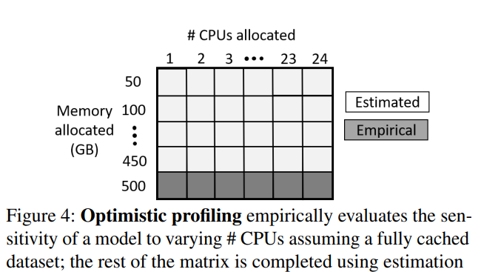
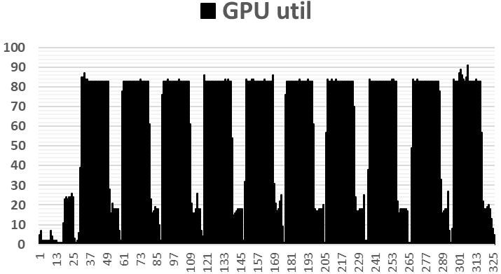
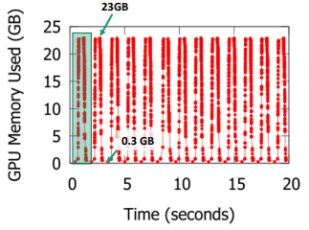
Optimistic Profiling
DNN training is highly predictable structure
Estimate of actual job throughput from a few iteration (J. Mohan et. al. “Analyzing and mitigating data stalls in DNN training”,arXiv`21)
To profile the incoming jobs resource demands, Construct Resource sensitivity matrix
Construct Discrete combination of CPU, memory allocation
Empirically evaluating training throughput for a few iterations
Resource predictable for a few iteration
W. Xiao, et al. "Gandiva: Introspective Cluster Scheduling for Deep Learning" OSDI, 2018.

Slide 14
Optimistic Profiling
But, profiling different combinations of CPU and memory can be very expensive
Assume One combination time: 1min, 24CPU, 500GB memory, each unit is 50GB.
All discrete combination time: 24*10 = 240min = 4hr
23CPU, 450GB memory allocation
One combination profiling time: 1min

Slide 15
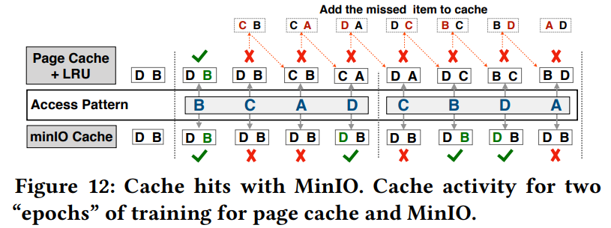
Optimistic Profiling
To solve this problem
DNN has unique data access pattern
Synergy introduces exploit the predictability in the relationship with job throughput and memory
DNN-specific caches MinIO*ensures that a job gets x% cache hits in every epoch If the memory allocated to the job holds x% of dataset
No cache replacement
1Epoch
2Epoch
Data size:4
Cache capacity: 2 (50%)
MinIO never replace data ensure at least 50% hit rate
J. Mohan et. al. “Analyzing and mitigating data stalls in DNN training”,arXiv,2021.
* J. Mohan et. al. “Analyzing and mitigating data stalls in DNN training”,arXiv, 2021.

Slide 16
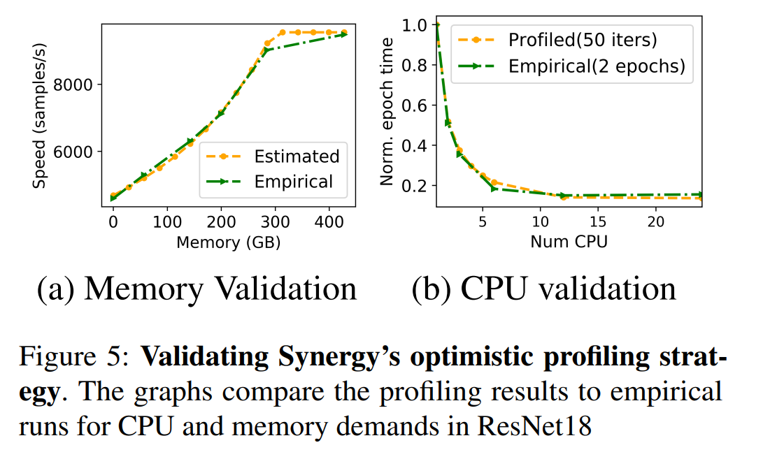
Optimistic Profiling
CPU allocation that determines the pre-processing time
Therefore, empirically profile the job for varying CPU values at full memory allocation
This leads to a 10× reduction in profiling time(240min → 24min)
Synergy’s estimation are within 3% of the empirical result

Slide 17
Placement mechanism
Synergy performs round-based scheduling (in this paper, 15min)
The set of runnable jobs is identified using a scheduling policy (FIFO, SRTF, LAS)
Packs these jobs onto the available servers in the cluster
Goal: allocate CPU, memory to each job so as to maximize the throughput

Slide 18
Placement mechanism
Synergy construct Job demand vector that indicates job’s resource demand
Identify GPU and best-case CPU, memory requirements for the job using resource sensitivity matrix
Pick the minimum value of CPU, memory that saturates the job throughput

Slide 19
Synergy-TUNE
Synergy-TUNE’s allocation must satisfy the following requirements
GPU, CPU and memory requested by a single-GPU job must all be allocated on same server
A multi-GPU job can be merge on one server or split across servers
Later case, CPU and memory allocations must be proportional across servers(for synchronization)

Slide 20
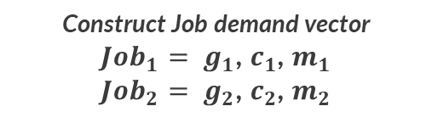
Synergy-TUNE
Synergy-TUNE Identify set of runnable jobs at the scheduling queue
GPU demands can be exactly satisfied by the available servers in the cluster
Then, sorts the runnable jobs by resource demands(priority: GPU→CPU→memory)
Job queue
Cluster
②Job scheduling
Policy: FIFO
① Profile each job
③ Identify set of runnable jobs
Optimistic profile
Scheduling queue
Scheduler
Synergy
TUNE
Each job has
resource sensitivity matrix
Incoming jobs scheduling by FIFO
Construct Job demand vector
${Job}_{1}= g_{1}$, $c_{1}$, $m_{1}$
${Job}_{2}= g_{2}$, $c_{2}$, $m_{2}$
: CPU
: Memory
: GPU

Slide 21
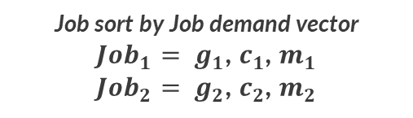
Synergy-TUNE
Synergy-TUNE picks the server with the least amount of free resources
Just fit the job demand vector(jdv)
If it is multi-GPU job
Find the minimum set of server with sufficient GPU that can fit jdv
Fully occupied
70% Free
④ Select least free server that fit with jdv
Scheduling queue
Synergy
TUNE
Job sort by Job demand vector
${Job}_{1}= g_{1}$, $c_{1}$, $m_{1}$
${Job}_{2}= g_{2}$, $c_{2}$, $m_{2}$
30% Free
Fit the job
50% Free
Fit the job
: CPU
: Memory
: GPU

Slide 22
Synergy-TUNE
However, the job cannot fit in the cluster along all demensions
Check jdv is greater than proportional share of resource
If then, switch the job’s demand to GPU-proportional share and retry allocation
If job still does not fit the cluster
Repeat 1. ignoring CPU, memory jdv
Find server that can just satisfy job’s GPU requirement(worst case)

Slide 23
Implementation
Implement Synergy and associated simulator in Python
Optimistic profiling
Synergy-TUNE
DNN jobs interact via thin API provided by the Synergy data iterator(for profiling)
DNN job implemented pytorch, DALI(pytorch task classification API)
Synergy use gRPC to communicate between the scheduler and jobs
Remote procedure call using communication protocol(HTTP) for transfer, developed by google

Slide 24
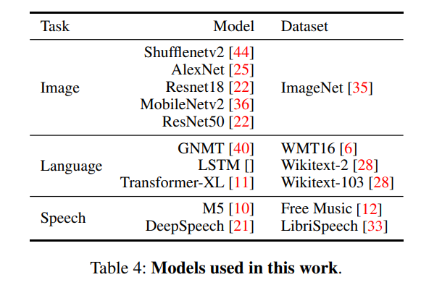
Evaluation
Experiment run on both physical and large simulated cluster
Physical server: 4 server, each server has 8GPU, 24CPU, 500GB DRAM
large cluster simulation: 16server/128GPU ,64 server/512GPU, server configuration is same above
10 different model
x5 image classification
x2 Speech recognition
Language translation
x2 Language modeling

Slide 25
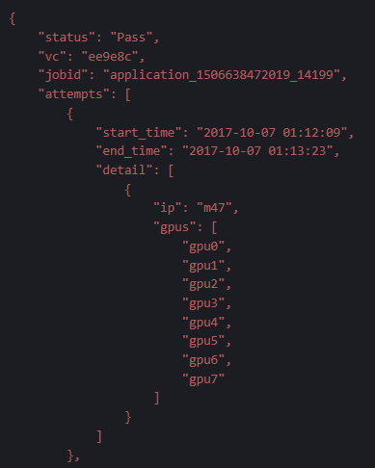
Evaluation
Trace
Run physical and simulated experiments using trace from Microsoft Philly cluster trace
Job GPU demand, arrival time, duration
Format: JSON
Dataset size: 6.6GB
Duration : Jobs submitted between 2017-08-07 ~ 2017-12-22
Total number of jobs: 117,325
Philly trace, https://github.com/msr-fiddle/philly-traces

Slide 26
Evaluation
Policies
Evaluate 4different scheduler : FIFO, SRTF, LAS, FTF
Metrics
Makespan(time to complete all jobs submitted at the beginning of the trace)
JCT(Job Completion Time)

Slide 27
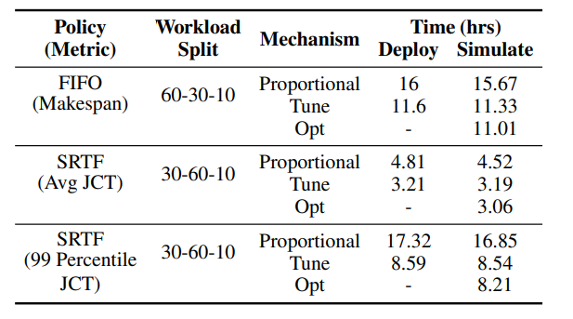
Evaluation
Comparison of GPU-proportion allocation with Synergy
Synergy-Opt: find the job server using linear programming, not deployed(highly overhead at physical experiment)
Physical cluster experiment
Case1: FIFO, image 60%, language 30%, speech 10%
Case2: SRTF, image 30%, language 60%, speech 10%
Synergy-TUNE reduced makespan by 1.4x
Synergy-TUNE reduced average JCT by 1.5x
Synergy-TUNE reduced 99 percentile JCT by 2x

Slide 28
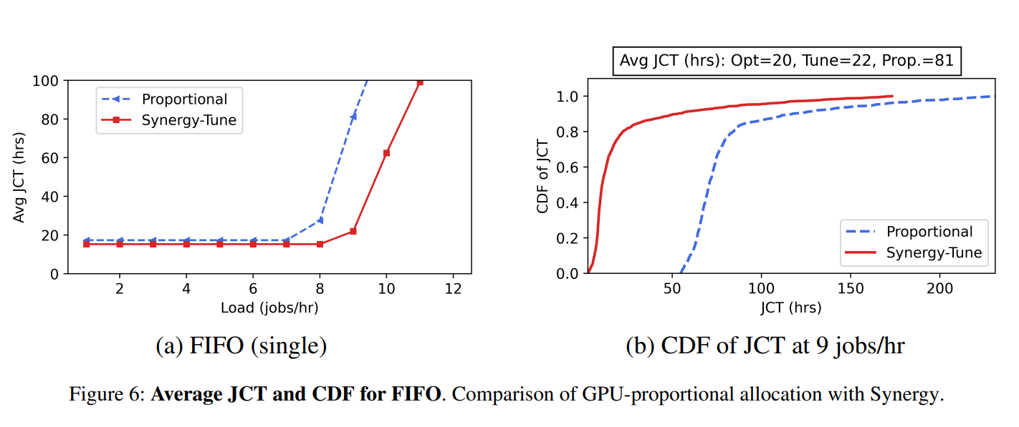
Evaluation
Configuration: 16 server/128GPU, 24CPU, 500GB RAM
Job scheduler policy: FIFO
Trace: Single GPU trace
Dataset: Image 20%, language 70%, speech 10%
Synergy_TUNE improves average JCT by up to 3.4x

Slide 29
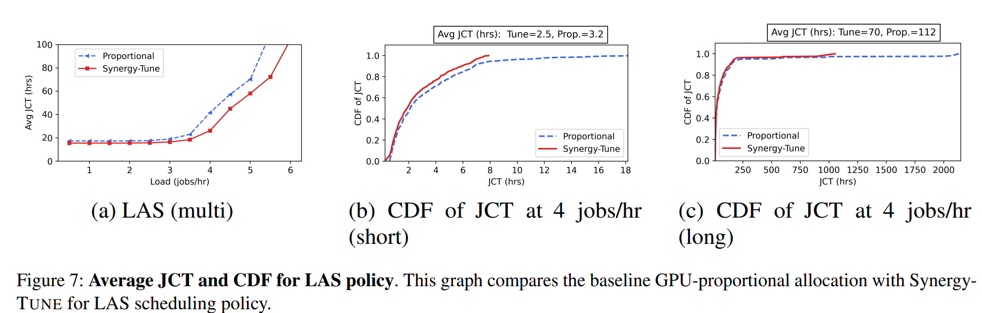
Evaluation
Job scheduler policy: LAS
Trace: multi GPU trace
Dataset: image 20%, language 70%, speech 10%

Slide 30
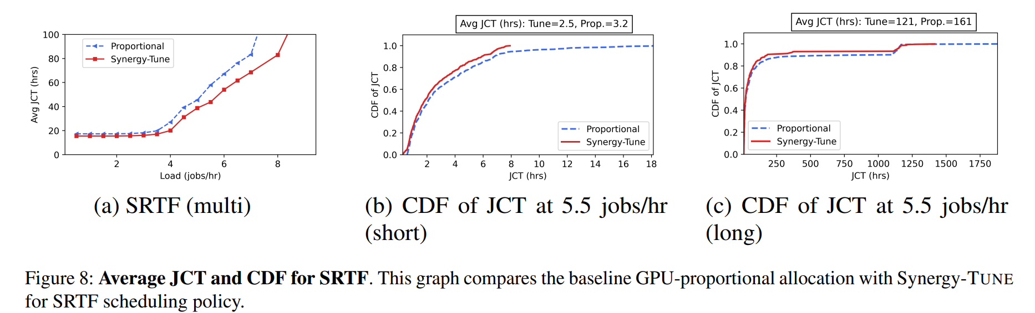
Evaluation
Job scheduler policy: SRTF
Trace: multi GPU trace
Dataset: image 20%, language 70%, speech 10%
Synergy_TUNE improves average JCT by up to 1.6x

Slide 31
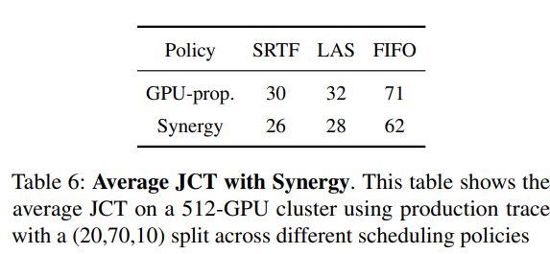
Evaluation
Configuration: 64server/512GPU, 24CPU, 500GB RAM
Job scheduler: FIFO, LAS, SRTF
Trace: subrange of Philly trace
Dataset: image 20%, language 70%, speech 10%

Slide 32
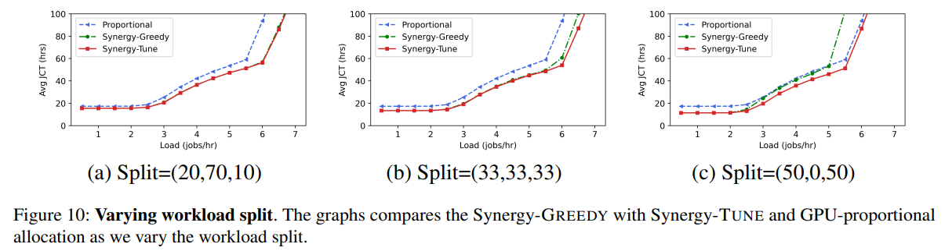
Evaluation
Varying workload split
Image : language : speech
Synergy-Greedy
Pick the next runnable job decided by the scheduling policy(no sort by resource priority)
Place it on the server that can satisfy the jobs demands in all demensions
Cause GPU fragmentation→ under utilized

Slide 33
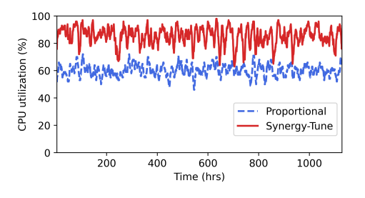
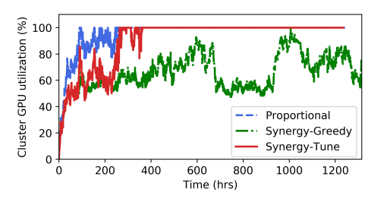
Evaluation
Resource utilization
Tested high load of 5.5 jobs/hour where the cluster GPU demand is higher than 100%
Synergy-TUNE utilized it up to a 90%, resulting in up to 1.5× lower average JCT
Synergy-GREEDY severely underutilizes GPU resources

Slide 34
Conclusion
Resource-sensitive DNN cluster scheduler : Synergy
Not all jobs exhibit the same level of sensitivity to CPU and memory allocation in DNN
Synergy can reduce average JCT by up to 3.4x compared to GPU-proportional

